Slide 1
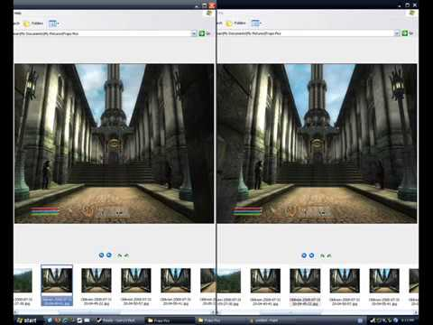
MATCHING FEATURE NEED ~3PIXELS
What depth means to the measurement?
Left image
Right image
target X
Case 1
Case 2
x1 and x2 are the physical position on camera sensors measured by um
3x3 pixel
The most common size of a sweep window to recognize a corner feature is 3x3 pixel
FORMULA: depth, focal length(f), baseline(B) and target position on camera sensor (x1-x2) has the following relationship:
target X
EXAMPLE: for a camera with sensor pixel size of 5.4um, focal length 4mm, baseline(distance between two camera) is 100mm, we use 3x3 pixel window for feature matching, so the maximum depth to see a sharp point is:
x1
x2
x1
x2
cam1
f
cam2
cam1
cam2
f
f
f
x1
Baseline B
x2
x1
Baseline B
x2
Near target has bigger position different on sensor:
Remark1: object textures determines the minimum target can be seen. Remember that matching feature between two image, need a pixel window, at least 3x3; sharper object, textures object need smaller pixel window; otherwise, we need to increase the window, maybe up to 50x50 pixel to cover an untextured target.
Remark2: the near object has large position difference on two camera sensor |x1-x2|, so it has more opportunity to be seen by trying using different pixel window size.
Remark3: larger pixel is better. Although larger camera pixel size reduce depth, it can receive more light information than a small pixel sensor. So for the same resolution, 5.4um pixel can see further than a 3.9um pixel sensor.
Remark4: You can manipulate baseline, focal length, resolution/pixel size to get the desired depth.
PRACTICAL APPLICATION: for accurate measurement, I will use more pixels, like 6x6 for the feature matching, so the depth in the above is around 12.35m

